Slide 1
ONLINE COMPLAINT REGISTRATION AND MANAGEMENT SYSTEM USING MERN STACK
TEAM BATCH ( ITB22 )
VIJAY SEKAR T G (211521205185)
SATHISH B (211521205140)
VASU R (211521205177)
VAMSEE KRISHNA H (211521205303)

Slide 2
Abstract
Development of an Online Complaint Registration and Management System using the MERN stack (MongoDB, Express.js, React.js, Node.js).
Purpose : To simplify the process of filing, tracking, and resolving complaints.
Key Features:
User-friendly interface for complaint registration.
Real-time tracking and updates.
Role-based access for users and administrators.
Secure data handling and communication.
Designed for scalability and adaptability across various sectors.

Slide 3
Introduction
Background : Traditional complaint management systems are often paper-based or fragmented, leading to inefficiencies and delays.
Objective : To develop a robust, scalable, and user-friendly web-based platform using the MERN stack to address these challenges.
Scope : This system can be implemented in government departments, educational institutions, or organizations to handle complaints effectively and improve service delivery.

Slide 4
Proposed system
The proposed system leverages the MERN stack to provide:
User Registration and Authentication :
Role-based access for users (citizens) and administrators (authorities).
Complaint Registration :
Easy-to-use forms for filing complaints.
Support for attachments like images or documents.
Complaint Tracking :
Real-time status updates on complaint resolution progress.
Admin Dashboard :
Tools for complaint categorization, prioritization, and resolution assignment.
Notifications :
Email and in-app notifications to keep users informed.

Slide 5
System Architecture
Frontend :
Built using React.js for a responsive and dynamic user interface.
Backend :
Powered by Node.js and Express.js for handling API requests and server-side logic.
Database :
MongoDB as the database for storing complaint records and user information.
Integration :
REST APIs to connect the frontend and backend seamlessly.

Slide 6
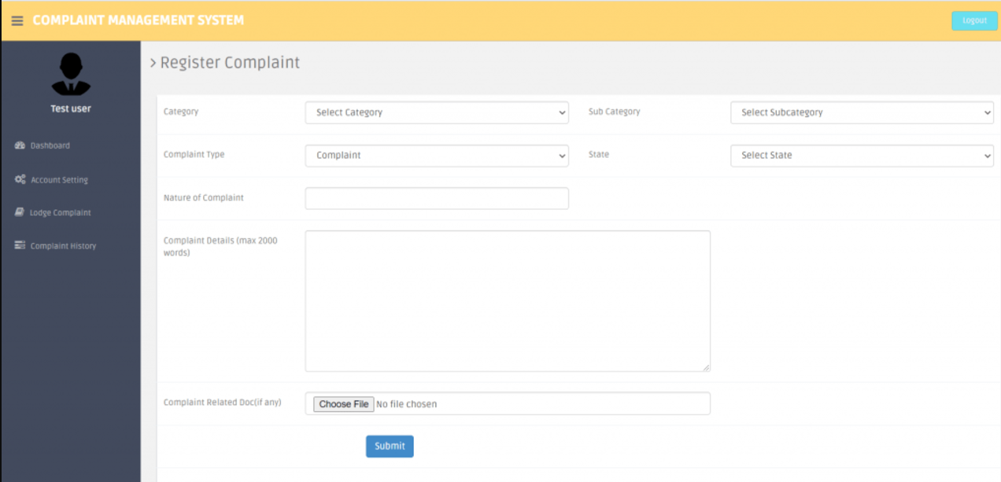
Model Screenshots

Slide 7
CONCLUSION
The MERN stack provides a powerful and flexible framework for building robust and scalable complaint registration systems.
The system provides an efficient, transparent, and user-centric approach to complaint management.
Enhances service delivery through real-time updates and streamlined processes.
Reduces administrative burden and fosters accountability.
Future potential includes:
AI-driven analytics for trend prediction.
Integration with mobile platforms for broader accessibility.

Slide 8
THANK YOU

